Slide 1
Logistic Regression
Introduction, Theory, and Applications

Slide 2
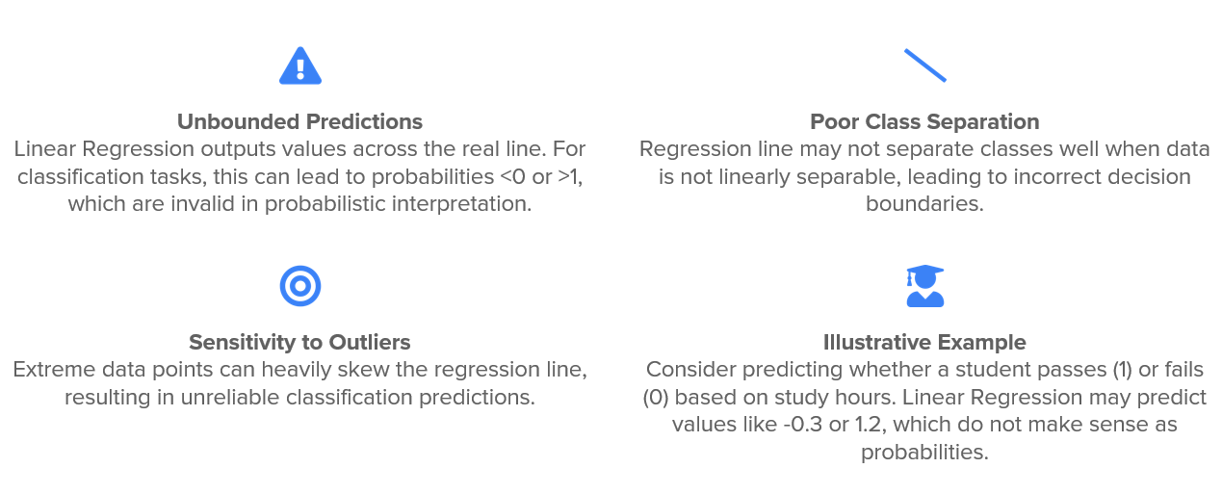
Recap…
Issues with Linear Regression for classification tasks

Slide 3
Logistic Regression
Logistic Regression is a supervised machine learning algorithm primarily used for classification problems.
It's a statistical method that models the log-odds of an event as a linear combination of one or more independent variables.
Its core purpose is to predict the probability that an observation belongs to a specific class or category.
Key Difference from Linear Regression
Unlike linear regression, which predicts continuous values (e.g., house price), logistic regression predicts a categorical outcome.
Its output is a probability between 0 and 1, rather than an unbounded continuous value.
What does probability has to do with the classification ?

Slide 4
Interpretation of probabilities
The returned probability can be used "as is" (e.g., 93.2% chance of spam) or converted to a binary category (e.g., "Spam" or "Not Spam") using a threshold (often 0.5).
Applications (Overview)
Widely used in healthcare, finance, marketing, social sciences, and engineering.
Question : Are all classification tasks in ML ultimately are regression tasks based on probabilities ?

Slide 5
“ Classification is regression onto probabilities, followed by a decision rule. ’’
*But in practice, classification and regression are considered separate because the learning objectives, metrics, and interpretation differ.

Slide 6
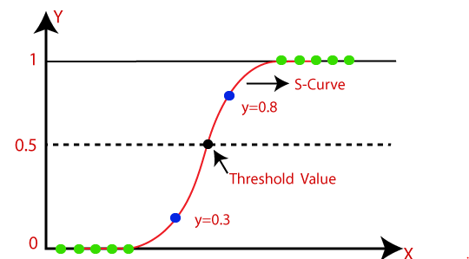
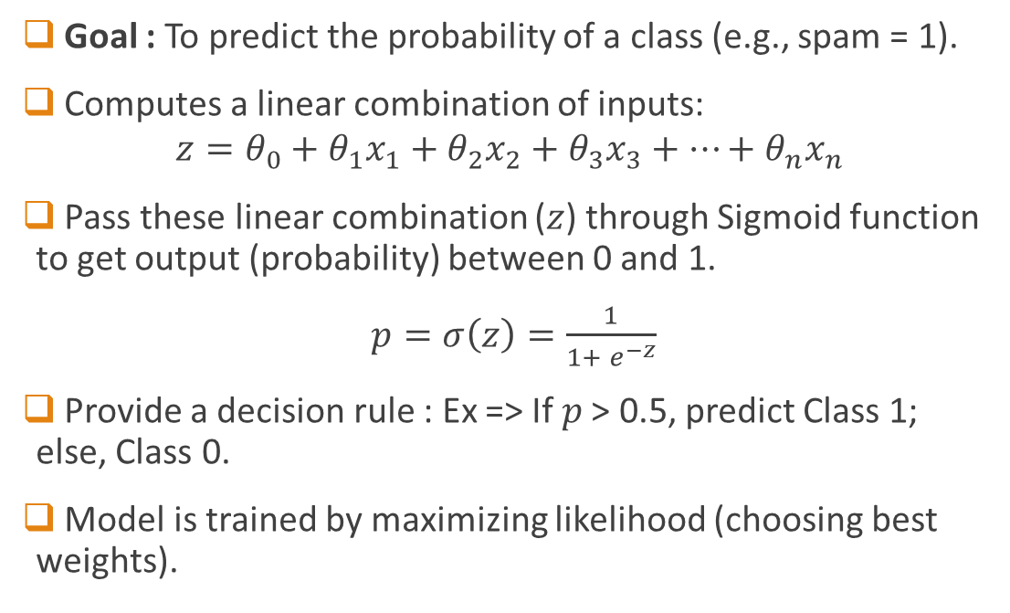
Idea Behind Logistic Regression
Goal : To predict the probability of a class (e.g., spam = 1).
Computes a linear combination of inputs:
$$z=θ_{0}+θ_{1}x_{1}+θ_{2}x_{2}+θ_{3}x_{3}+…+θ_{n}x_{n}$$
Pass these linear combination ($z$) through Sigmoid function to get output (probability) between 0 and 1.
$p=σ\left(z\right)=\frac{1}{1+ e^{−z}}$
Provide a decision rule : Ex => If 𝑝 > 0.5, predict Class 1; else, Class 0.
Model is trained by maximizing likelihood (choosing best weights).

Slide 7
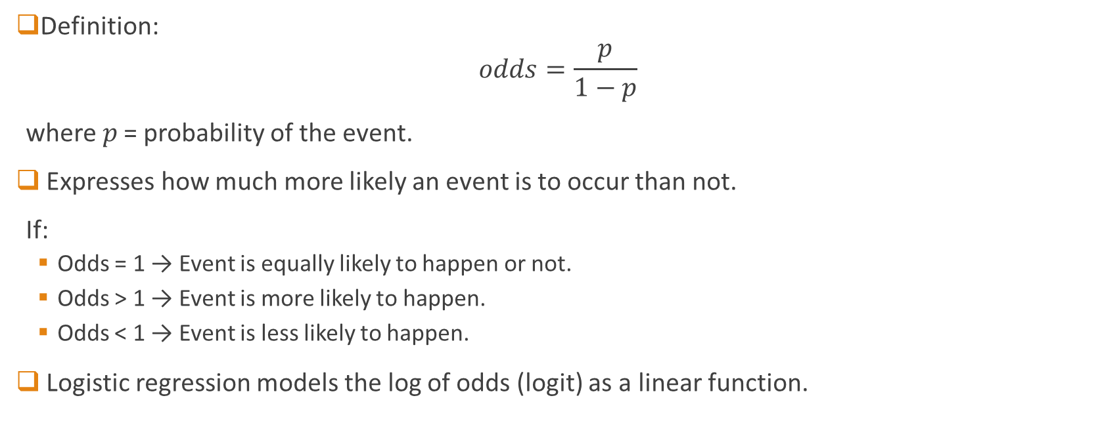
Understanding Odds in Classification
Definition:
$$odds=\frac{p}{1−p}$$
where 𝑝 = probability of the event.
Expresses how much more likely an event is to occur than not.
If:
Odds = 1 → Event is equally likely to happen or not.
Odds > 1 → Event is more likely to happen.
Odds < 1 → Event is less likely to happen.
Logistic regression models the log of odds (logit) as a linear function.

Slide 8
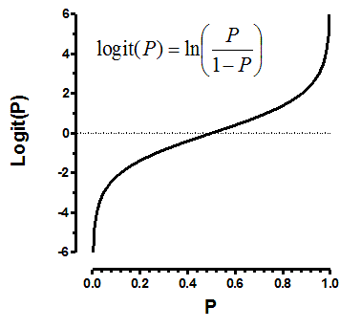
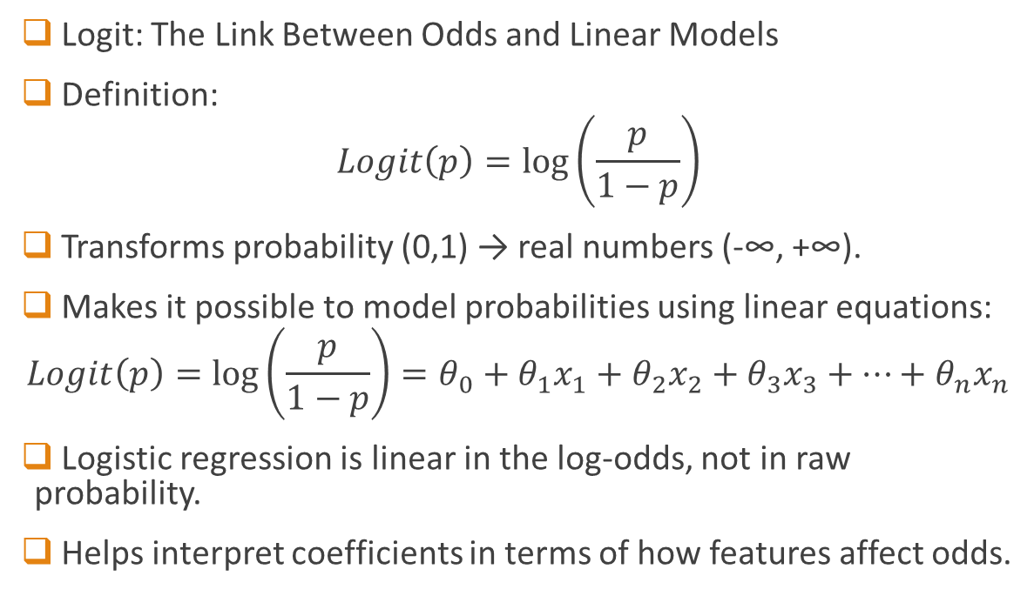
The Logit Function
Logit: The Link Between Odds and Linear Models
Definition:
$$Logit\left(p\right)=log⁡\left(\frac{p}{1−p}\right)$$
Transforms probability (0,1) → real numbers (-∞, +∞).
Makes it possible to model probabilities using linear equations:
$$Logit\left(p\right)=\log\left(\frac{p}{1−p}\right)=θ_{0}+θ_{1}x_{1}+θ_{2}x_{2}+θ_{3}x_{3}+…+θ_{n}x_{n}$$
Logistic regression is linear in the log-odds, not in raw probability.
Helps interpret coefficients in terms of how features affect odds.
H.W. : Show how Sigmoid and logit functions are related in the context of Logistic regression ?

Slide 9
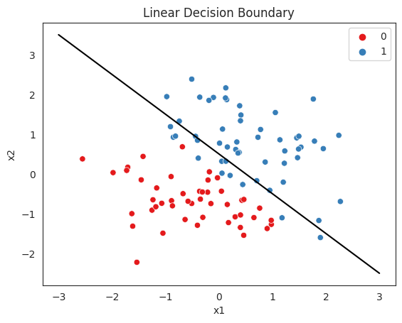
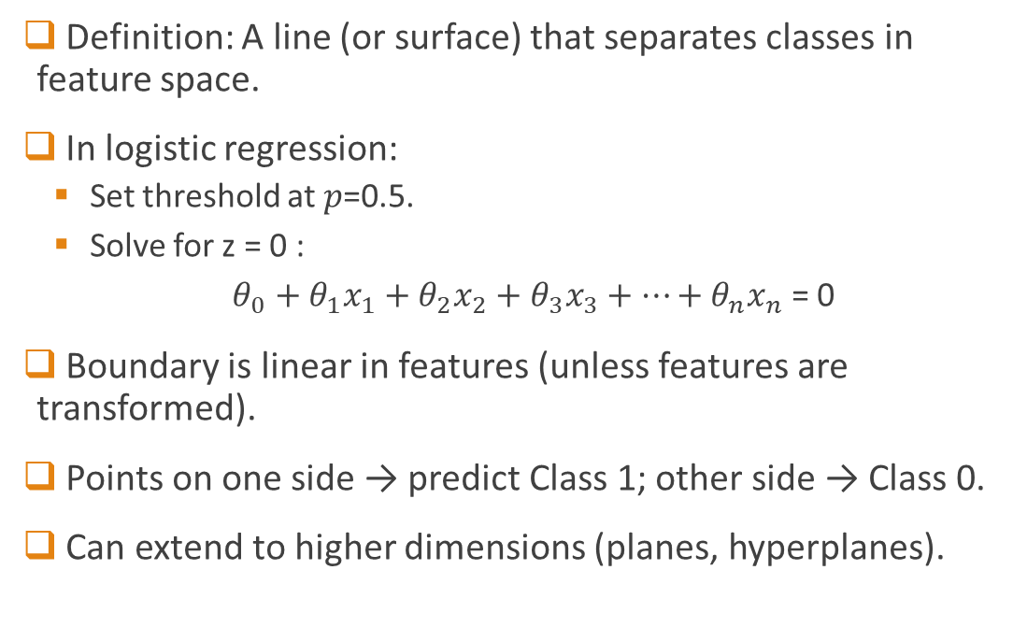
Decision boundary
Definition: A line (or surface) that separates classes in feature space.
In logistic regression:
Set threshold at 𝑝=0.5.
Solve for z = 0 :
$θ_{0}+θ_{1}x_{1}+θ_{2}x_{2}+θ_{3}x_{3}+…+θ_{n}x_{n}$ = 0
Boundary is linear in features (unless features are transformed).
Points on one side → predict Class 1; other side → Class 0.
Can extend to higher dimensions (planes, hyperplanes).

Slide 10
The key question : How to optimize the weights for best possible classification ?
Or
How “learning” is done in Logistic Regression ?

Slide 11

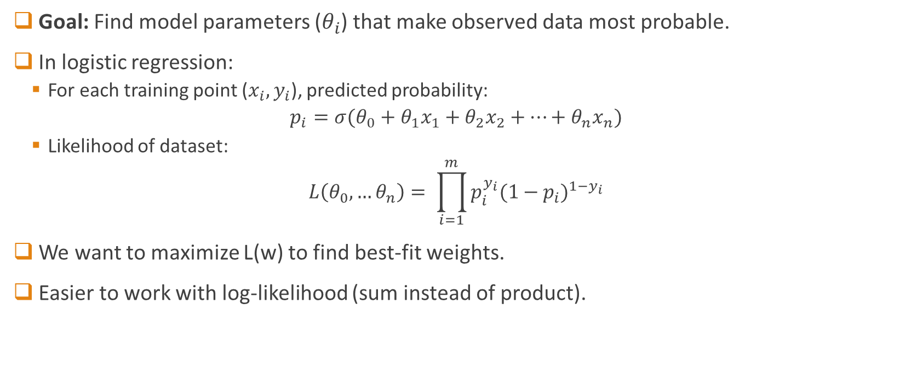
Maximum Likelihood: The Core Idea
Goal: Find model parameters ($θ_{i}$) that make observed data most probable.
In logistic regression:
For each training point ($x_{i},y_{i}$), predicted probability:
$$p_{i}=σ(θ_{0}+θ_{1}x_{1}+θ_{2}x_{2}+…+θ_{n}x_{n})$$
Likelihood of dataset:
$$L\left(θ_{0},…θ_{n}\right)= \prod_{i=1}^{m}{p_{i}^{y_{i}}{(1−p_{i})}^{1−y_{i}}}$$
We want to maximize L(w) to find best-fit weights.
Easier to work with log-likelihood (sum instead of product).
$y_{i}$ are class labels (0, 1)

Slide 12
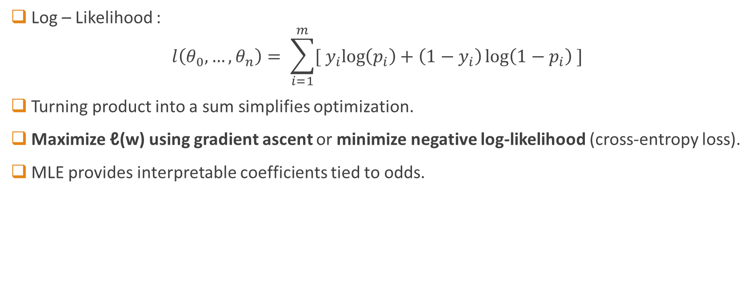
Log-Likelihood in Logistic Regression
Log – Likelihood :
$$l\left(θ_{0},…,θ_{n}\right)= \sum_{i=1}^{m}{[{ y}_{i}\log\left(p_{i}\right)+\left(1−y_{i}\right)\log\left(1−p_{i}\right) ]}$$
Turning product into a sum simplifies optimization.
Maximize ℓ(w) using gradient ascent or minimize negative log-likelihood (cross-entropy loss).
MLE provides interpretable coefficients tied to odds.

Slide 13
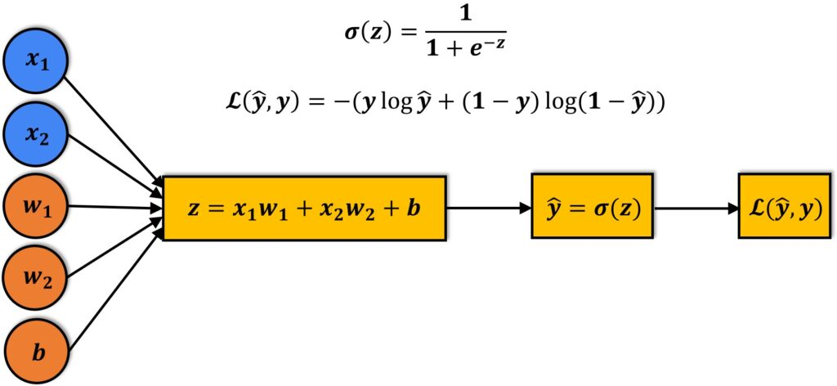
Overview
Learning => Minimising the negative log-likelihood

Slide 14
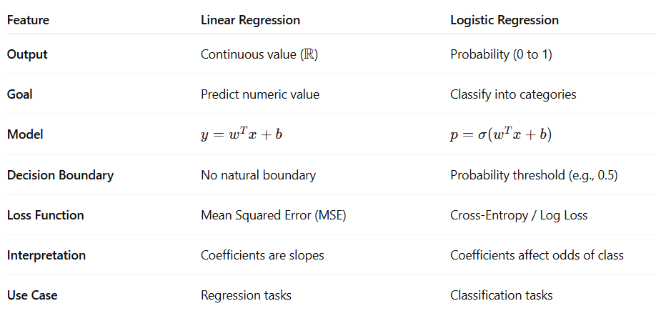
Comparison with Linear Regression

Slide 15
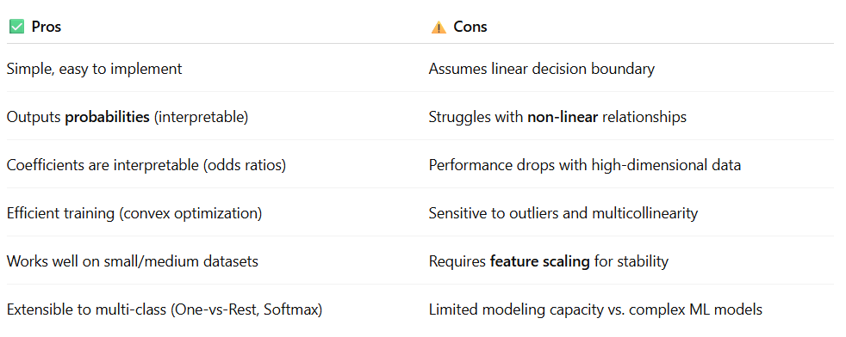
Pros & Cons of Logistic Regression
NOTE : Logistic Regression is a strong baseline for classification — interpretable, simple, and efficient, but not suited for complex, highly non-linear problems.

Slide 16
Looking back at loss/cost function for logistic regression
Why we suddenly switched to “negative log likelihood” instead of MSE ?

Slide 17
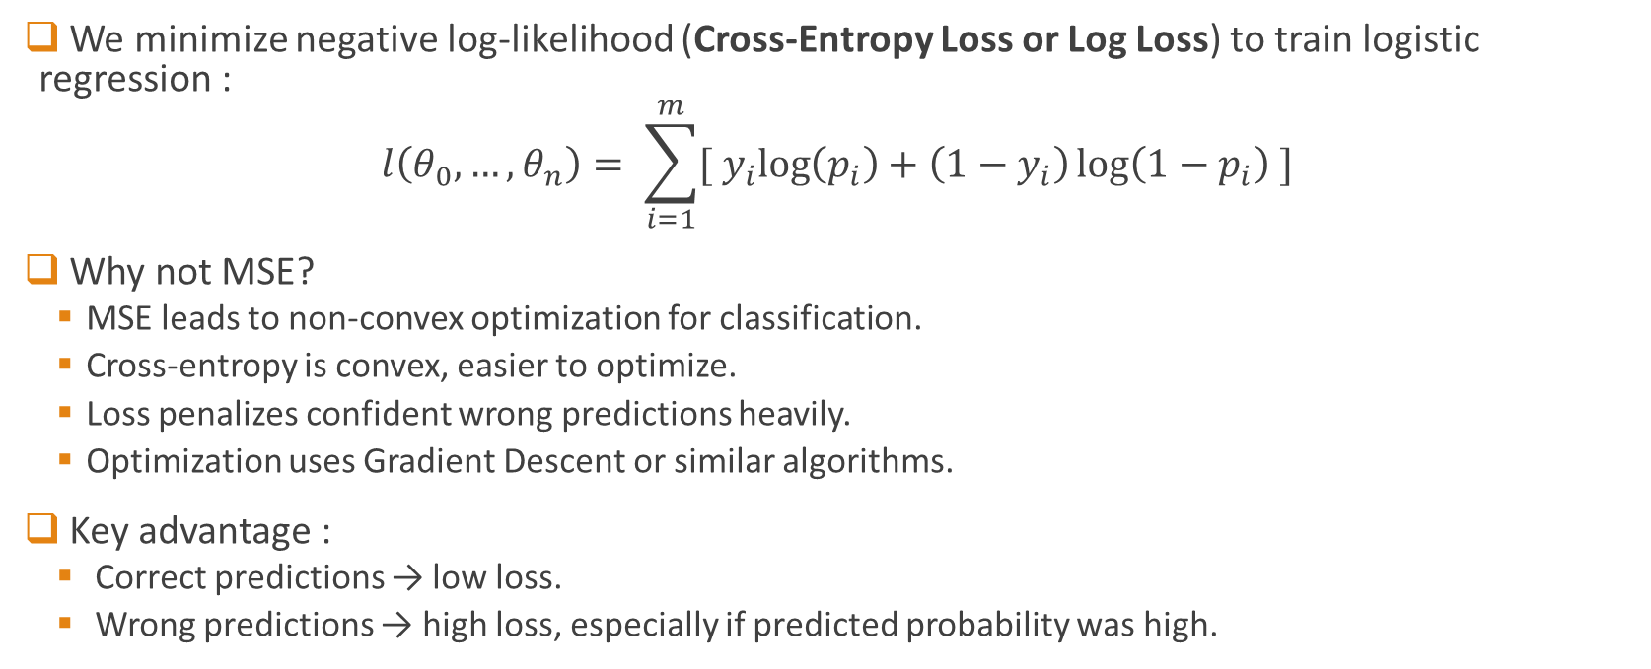
Cost Function : Cross-Entropy
We minimize negative log-likelihood (Cross-Entropy Loss or Log Loss) to train logistic regression :
$$l\left(θ_{0},…,θ_{n}\right)= \sum_{i=1}^{m}{[{ y}_{i}\log\left(p_{i}\right)+\left(1−y_{i}\right)\log\left(1−p_{i}\right) ]}$$
Why not MSE?
MSE leads to non-convex optimization for classification.
Cross-entropy is convex, easier to optimize.
Loss penalizes confident wrong predictions heavily.
Optimization uses Gradient Descent or similar algorithms.
Key advantage :
Correct predictions → low loss.
Wrong predictions → high loss, especially if predicted probability was high.
Q. : How entropy comes in this picture ? Why the name “Cross-Entropy” ?

Slide 18
What about classification in multiple classes/categories ?

Slide 19
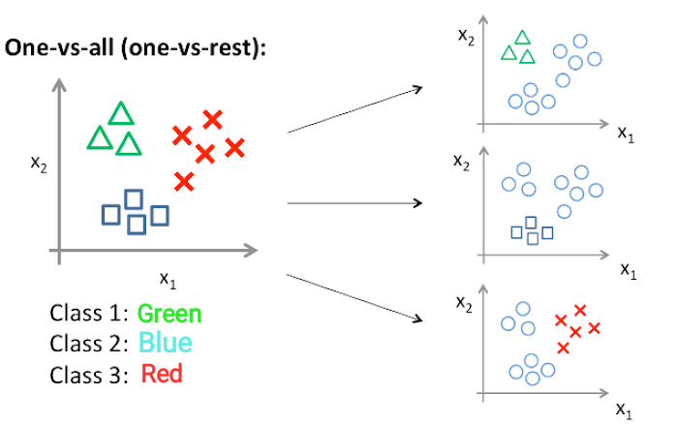
Multi class classification
Binary logistic regression → two classes (0 or 1).
For multiple classes (K classes), two main approaches:
One-vs-Rest (OvR):
Train K separate binary classifiers.
Pick the class with highest probability.
One-vs-One (OvO):
Train a classifier for each pair of classes.
Use voting to decide final class.

Slide 20

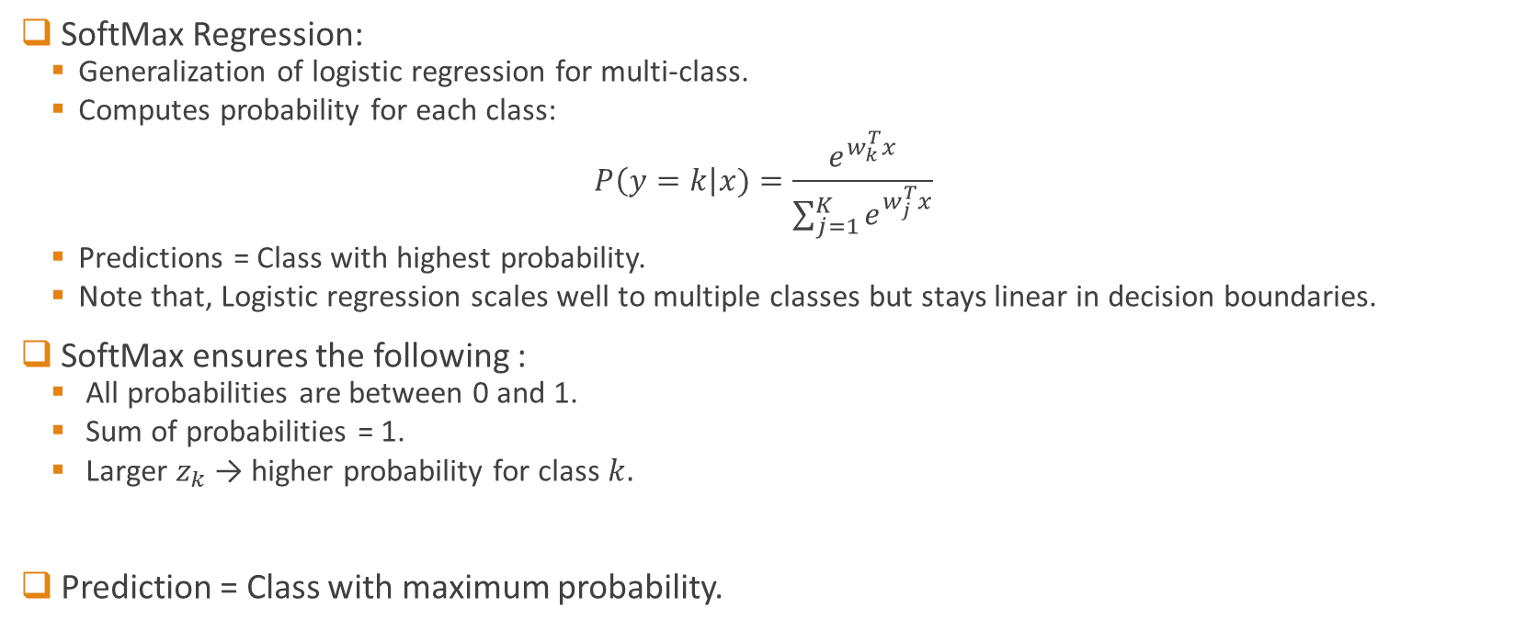
Multi class classification with SoftMax
SoftMax Regression:
Generalization of logistic regression for multi-class.
Computes probability for each class:​
$$P\left(y=k\right|x)=\frac{e^{w_{k}^{T}x}}{\sum_{j=1}^{K}{e^{w_{j}^{T}x}}}$$
Predictions = Class with highest probability.
Note that, Logistic regression scales well to multiple classes but stays linear in decision boundaries.
SoftMax ensures the following :
All probabilities are between 0 and 1.
Sum of probabilities = 1.
Larger $z_{k}$ → higher probability for class $k.$
Prediction = Class with maximum probability.
$$z_{k}=w_{k}^{T}x$$

Slide 21
Multi class classification with SoftMax
SoftMax is like applying sigmoid but extended to multiple classes.
Turns raw scores into something we can interpret as probabilities.
Example:
Three classes with raw scores [2, 1, 0].
Apply SoftMax → Probabilities [ 0.71, 0.26, 0.03].
Note that probabilities are adding up to 1, which is important.

Slide 22
Now, the main question : How do we know how well my model is performing ?
Or
How to evaluate my model in classification ?

Slide 23
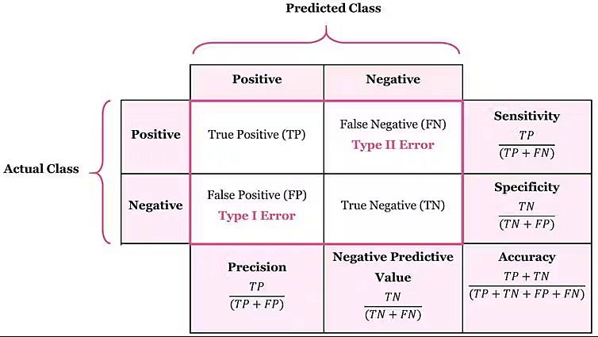
The Confusion Matrix
A key diagnostic tool for evaluating classification tasks
Several evaluation metric can be calculated based on confusion matrix

Slide 24
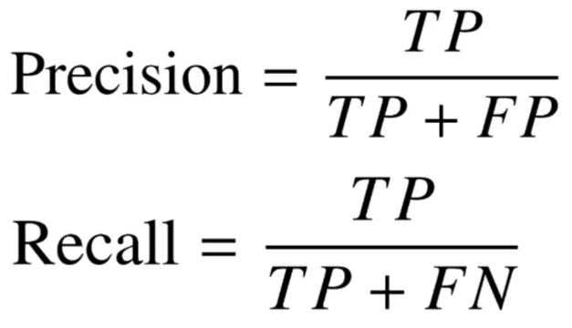
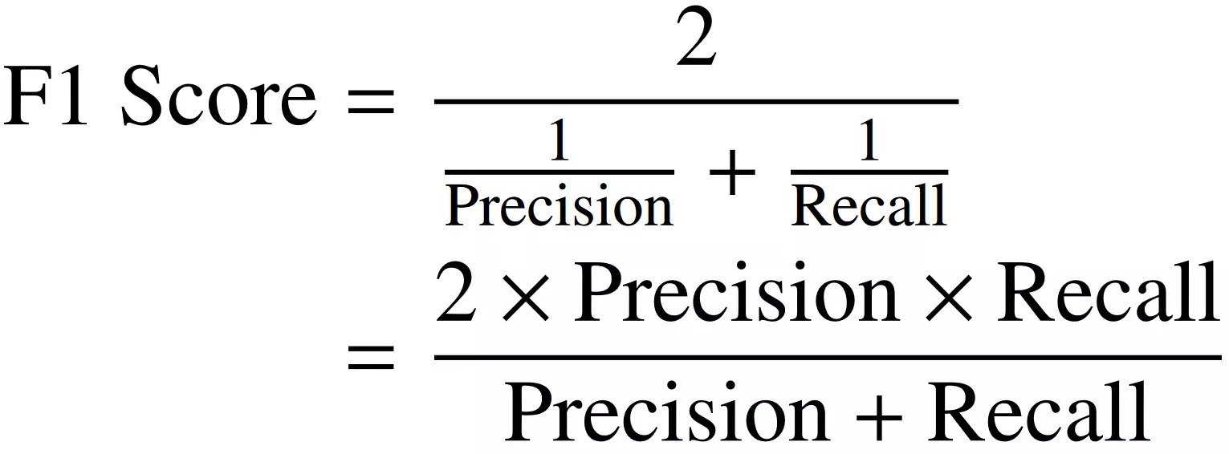
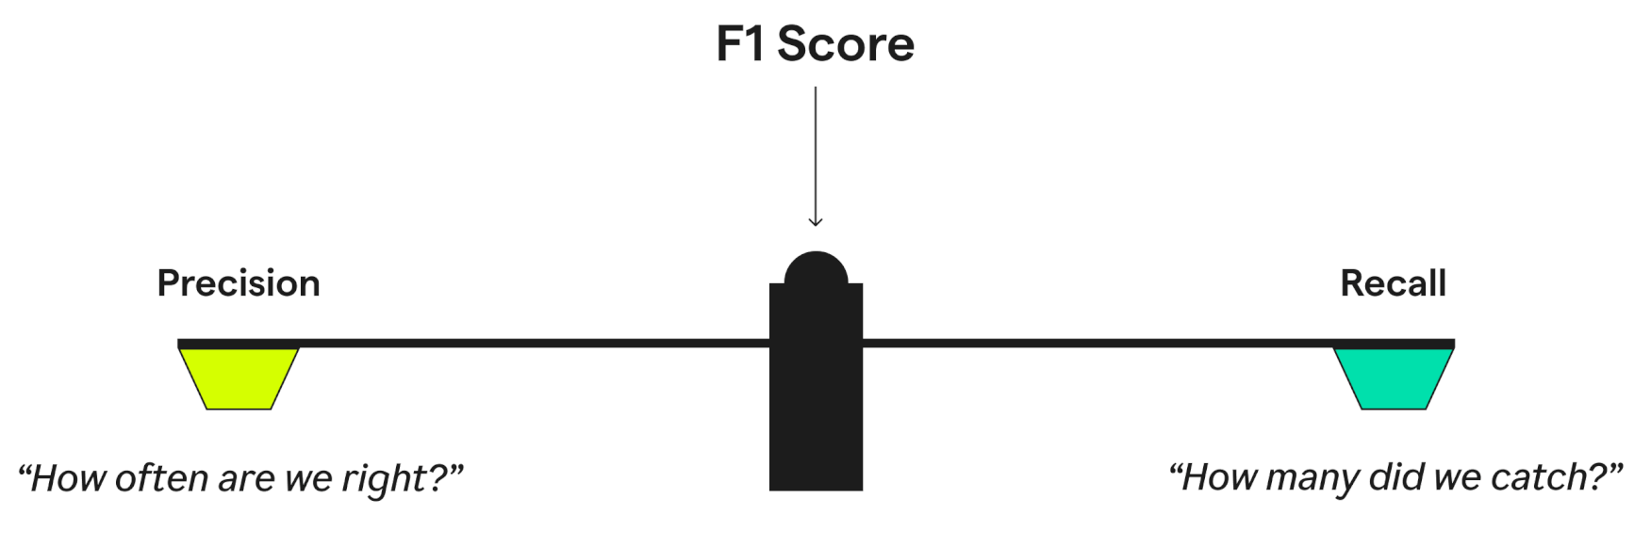
The F1 - score
Image credit : grammarly.com

Slide 25
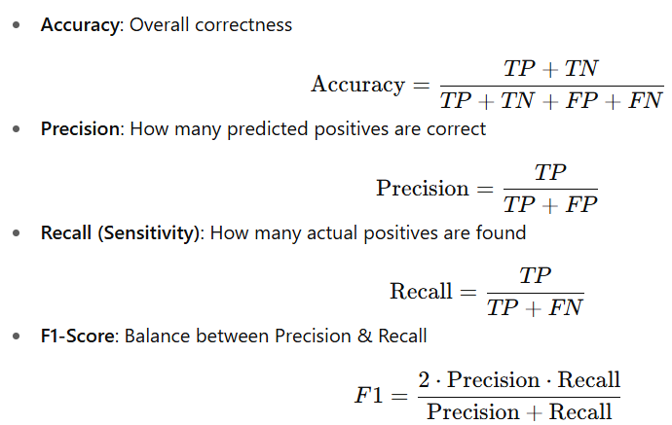
Overall
Points to be noted
Accuracy can be misleading with imbalanced data.
Precision vs Recall = trade-off (depends on application).
F1-score useful when classes are imbalanced.
Q. : What do we mean by imbalanced data ?

Slide 26
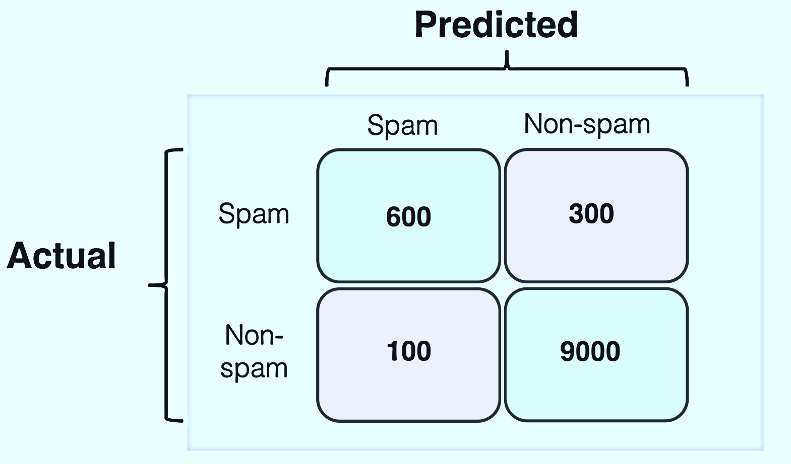
Example
A ML model was used to classify 10,000 emails in “spam” or “Non-spam”. The confusion matrix for the same is given here. Evaluate the model performance by calculating :
Precision
Recall
Accuracy
F1-score

Slide 27
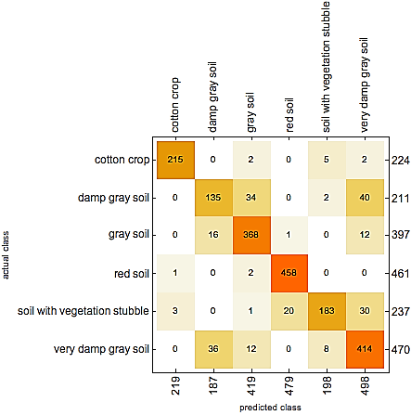
Confusion matrix for multi-class classification
The logic and the principles are same as that of binary classification.
Each class treated as “positive” in a one-vs-all manner.
Metrics (Precision, Recall, F1 etc.) need averaging strategies:
Macro Average: Equal weight to each class.
Micro Average: Weighted by sample count.

Slide 28
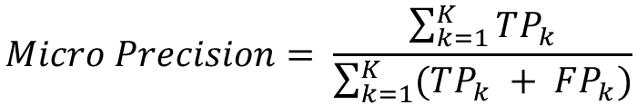
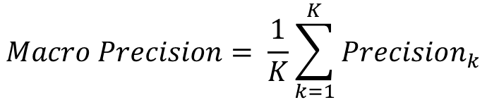
Averaging strategies
Macro Averaging (treat all classes equally)
Compute Precision/Recall/F1 for each class.
Then take the average across all classes.
Gives equal importance to each class.
Good when classes are balanced.
Formula :
Micro Averaging (treat all samples equally)
Aggregate TP, FP, FN across all classes.
Then compute Precision/Recall/F1 from totals.
Gives more weight to larger classes.
Good when classes are imbalanced.
Formula :
$$Macro Precision= \frac{1}{K}\sum_{k=1}^{K}{Precision_{k}}$$
$$Micro Precision= \frac{\sum_{k=1}^{K}{TP_{k}}}{\sum_{k=1}^{K}{(TP_{k} + FP_{k})}}$$

Slide 29
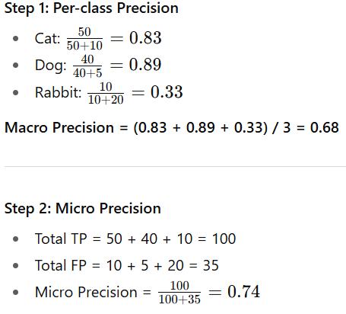
Examples
Consider the following data for a classification tasks where classes are : Cat, Dog, Rabbit
Classes | TP | FP | FN
Cat | 50 | 10 | 5
Dog | 40 | 5 | 15
Rabbit | 10 | 20 | 10
Macro treats Rabbit equally, so overall score drops (0.68).
Micro weights by total samples, so strong Cat/Dog performance dominates (0.74).

Slide 30
Overview
From Regression to Classification
Linear regression unsuitable for classification → predictions unbounded.
Logistic regression adds sigmoid to output probabilities (0–1).
Uses odds & logit for linear modelling of probabilities.
Model & Training
Decision boundary at 𝑝 = 0.5.
Parameters estimated via Maximum Likelihood Estimation (MLE).
Cost Function: Cross-Entropy (Log Loss).
Extensions
Multi-class classification: One-vs-Rest, One-vs-One, SoftMax.
SoftMax generalizes logistic regression to multiple classes.
Evaluation
Confusion Matrix: Foundation for metrics.
Metrics: Accuracy, Precision, Recall, F1.
Multi-class evaluation needs Macro vs Micro averaging.

